Slide 1
Data Science with Python Foundation
Training Taster

Slide 2
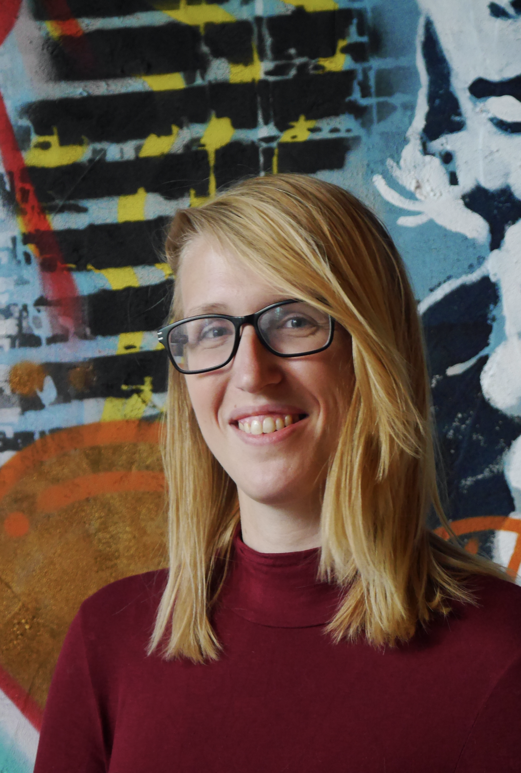
About me
Data Scientist at GoDataDriven
BSc & MSc Artificial Intelligence
5 years industry experience in Machine Learning
Co-chair PyData Amsterdam conference & meetup group
Marysia Winkels

Slide 3
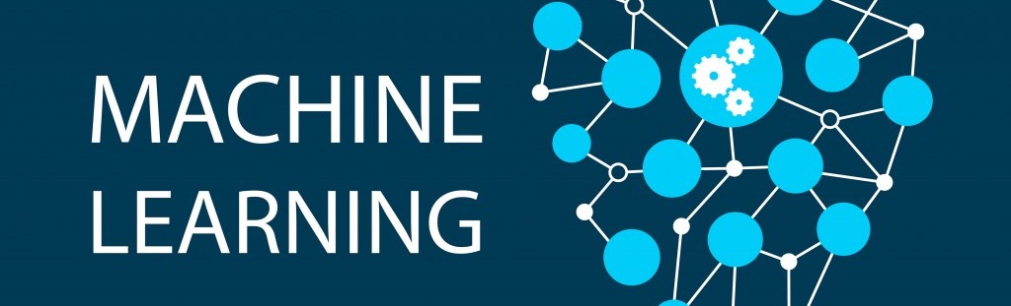
Program
What is data science?
Examples of data science projects
What is the role of a data scientist?
What is machine learning?
Example project of a machine learning with scikit-learn

Slide 4
Data science

Slide 5
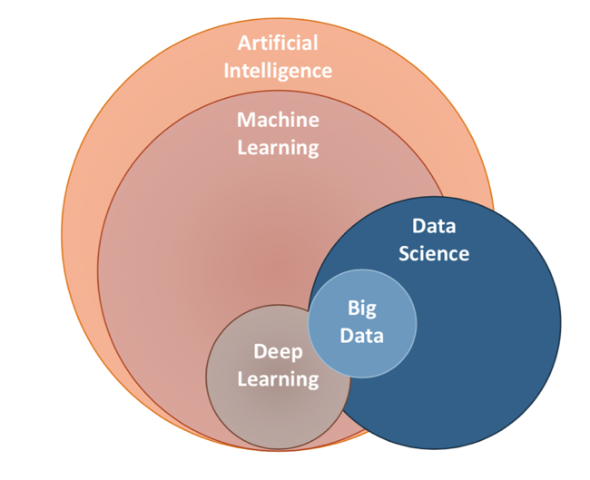
Artificial Intelligence Machine Learning Data science

Slide 6
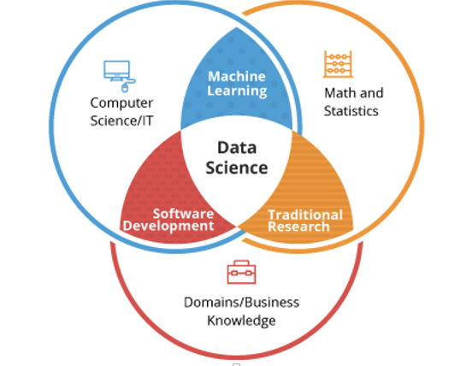
Data science vs Machine Learning

Slide 7
Data Science applications

Slide 8

Prediction

Slide 9
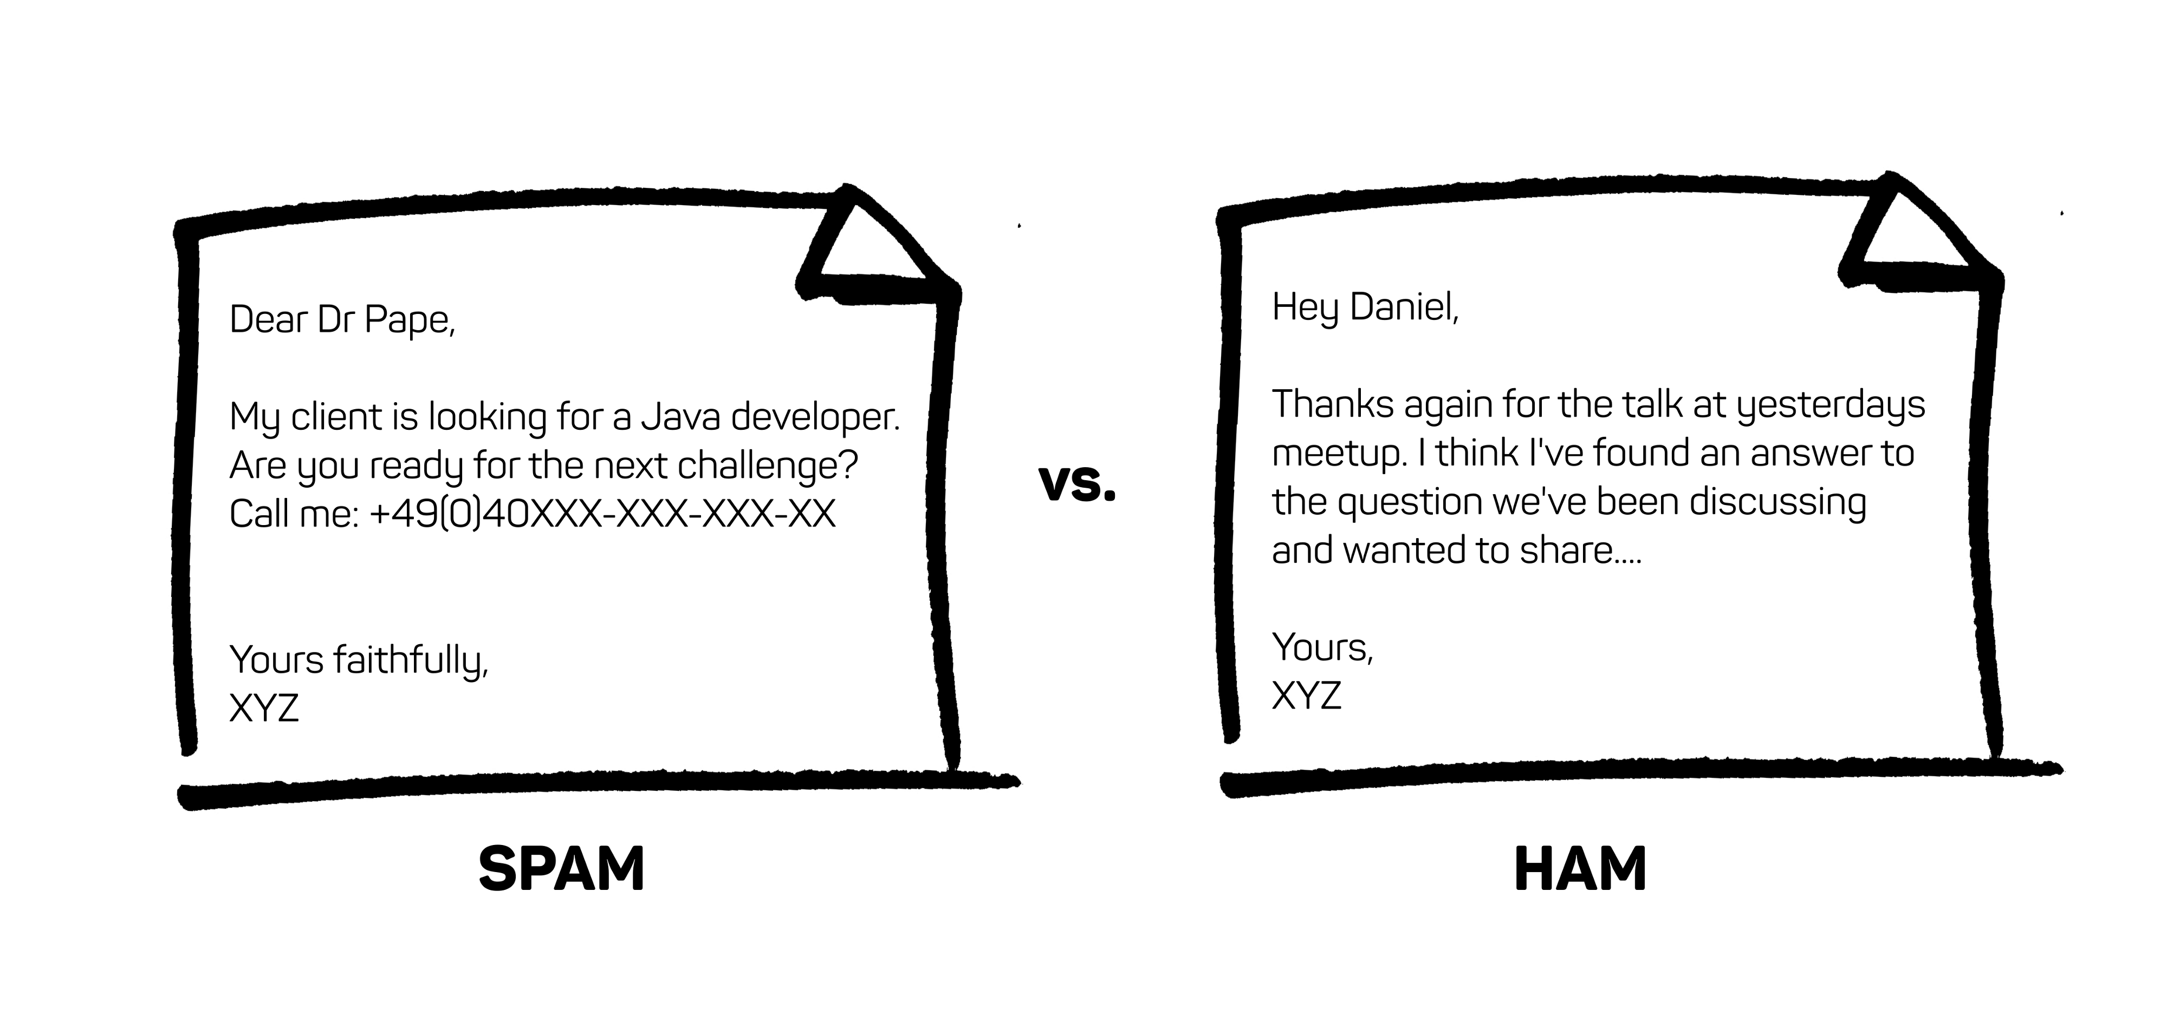
Classification
Source: Shanika Pererra

Slide 10
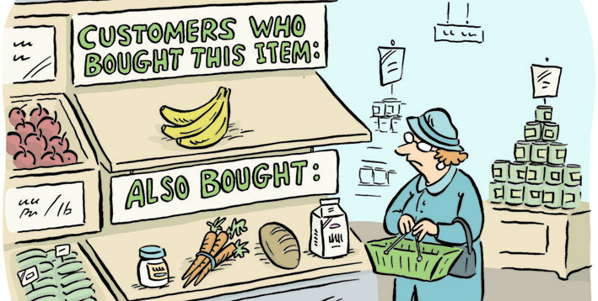
Recommendations
Source: kaggle.com

Slide 11

Fraud detection
Source: Chelsea Turner

Slide 12
Role of a data scientist

Slide 13
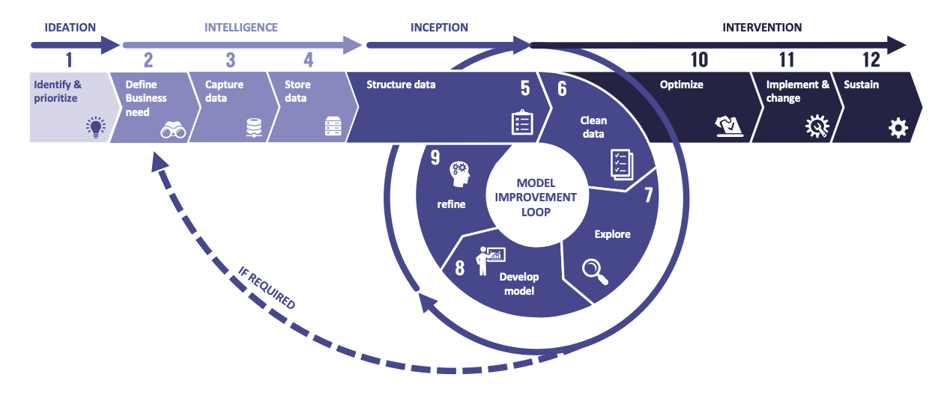
Use case approach

Slide 14
Data scientist’s part

Slide 15

Data scientist skills
Proficiency with Python or R
Understanding of data wrangling & visualisation
Knowledge of machine learning
Data modelling and evaluation skills

Slide 16
Use Case: Penguins

Slide 17
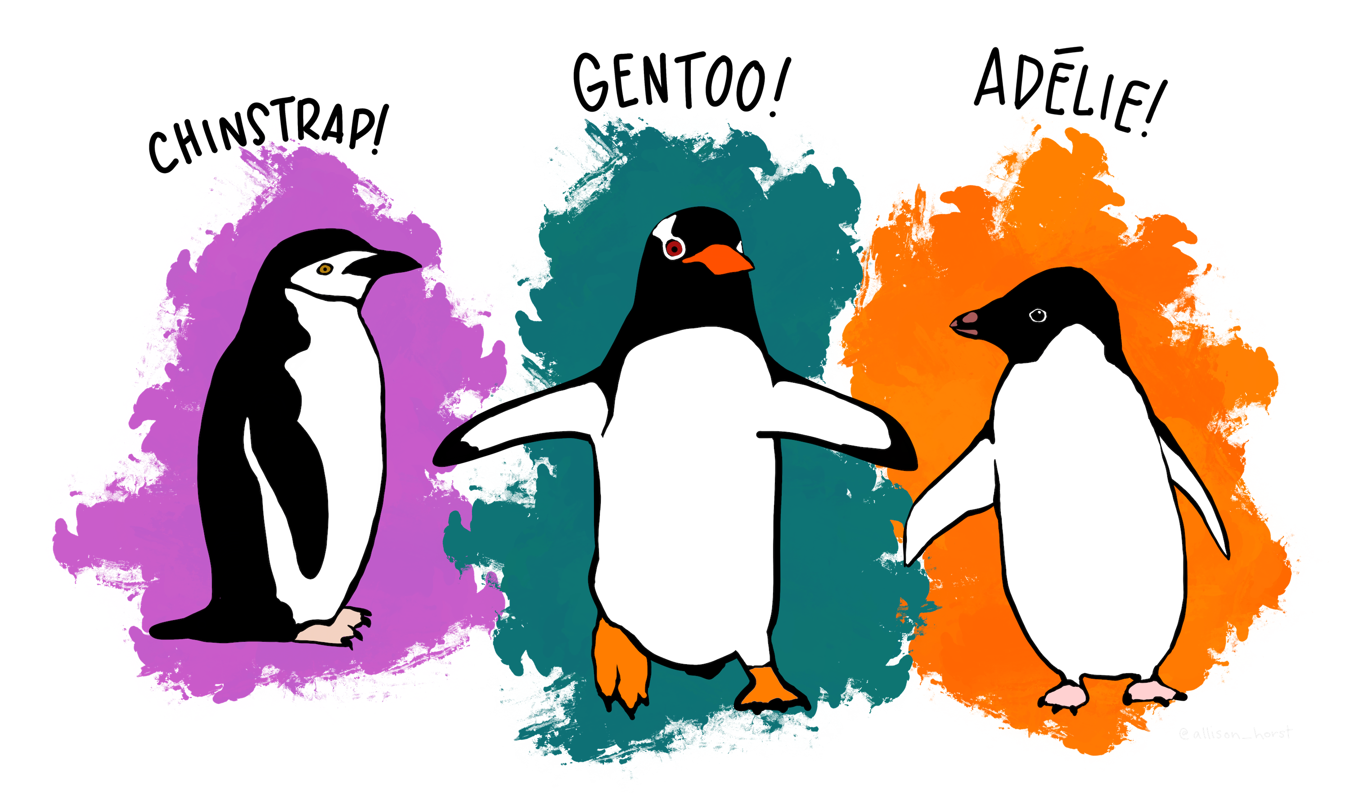
Meet the Palmer Penguins

Slide 18
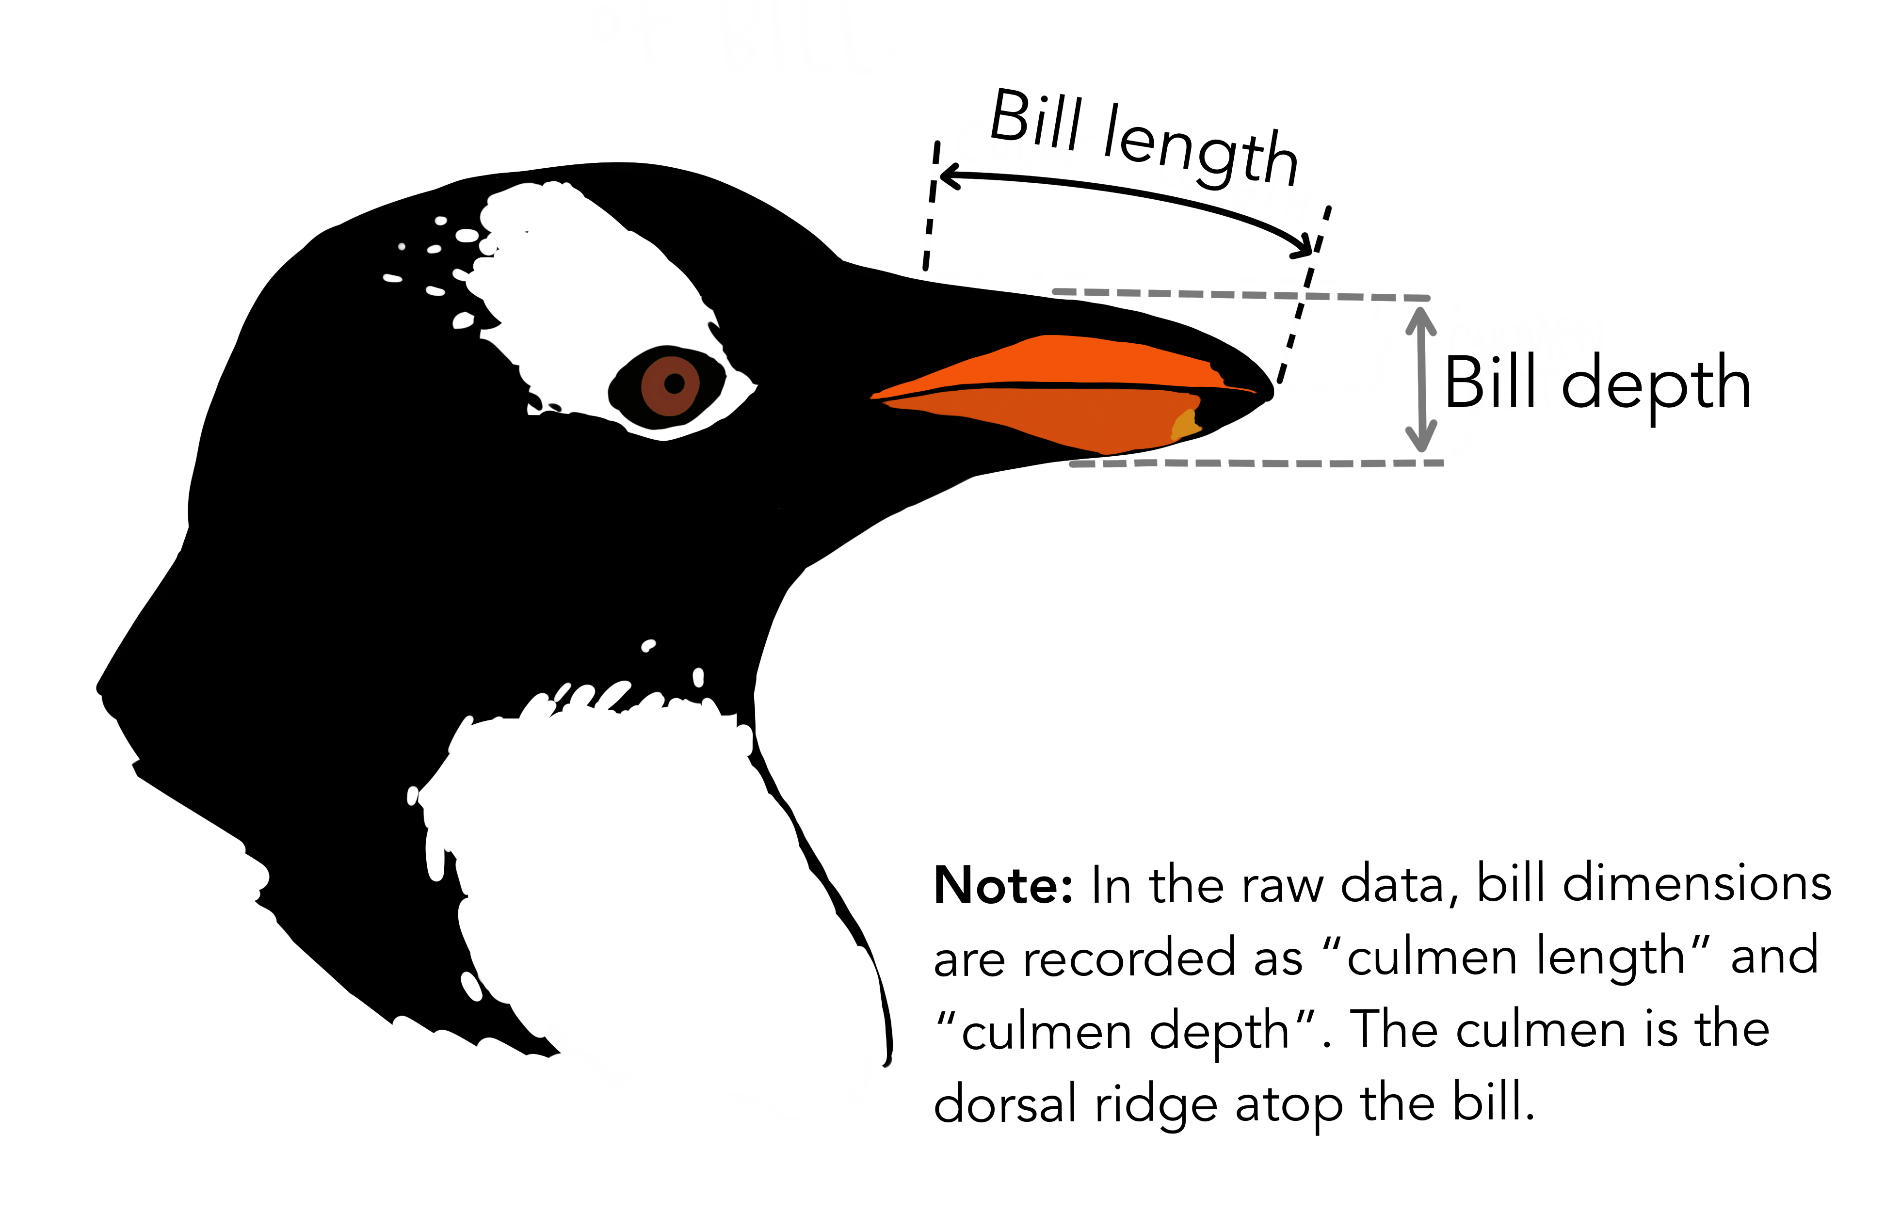
Palmer Penguins dataset
Bill length (mm)
Bill depth (mm)
Flipper length (mm)
Body mass (grams)

Slide 19
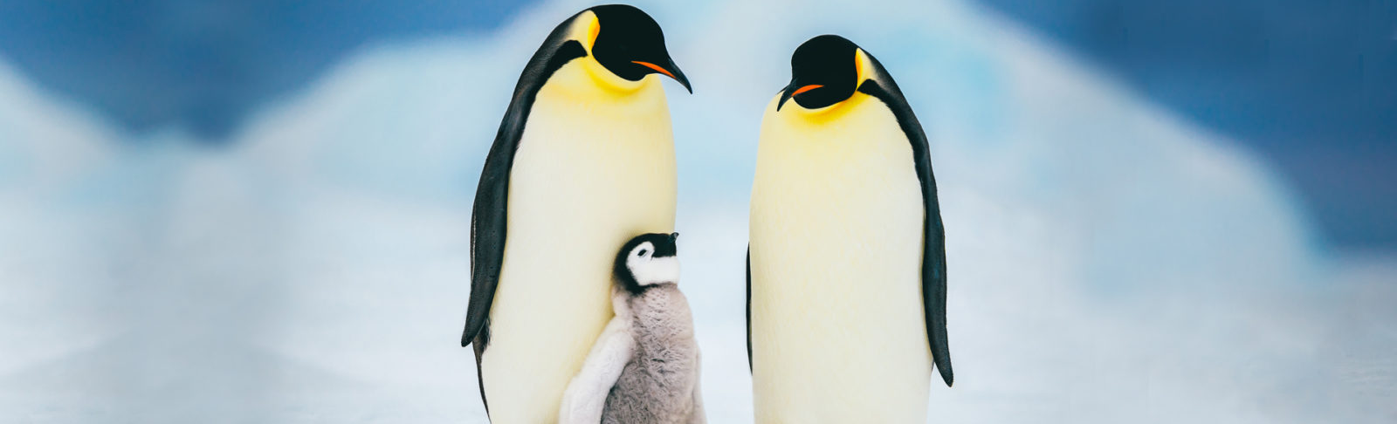
Steps
1. Data exploration (data wrangling & visualisation)
2. Creating a model
3. Evaluation

Slide 20
Data Exploration

Slide 21
Data exploration: tools
Python
Pandas
Visualisation library, e.g. matplotlib, seaborn or altair.
Want to learn more?
Python for Data Analysts!

Slide 22
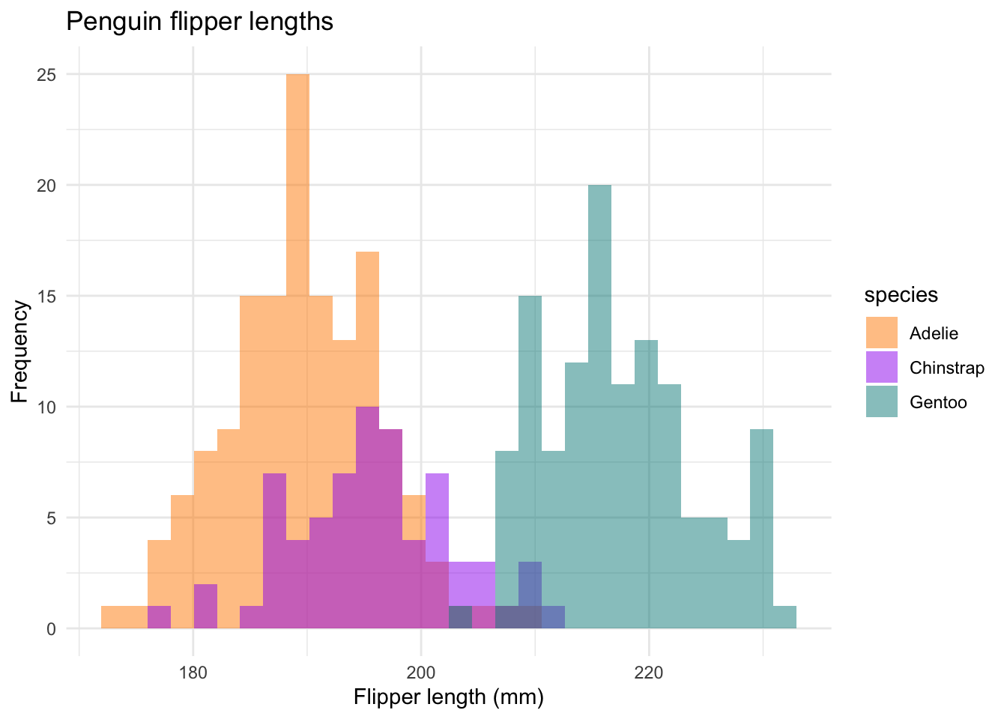
Data exploration: penguins

Slide 23
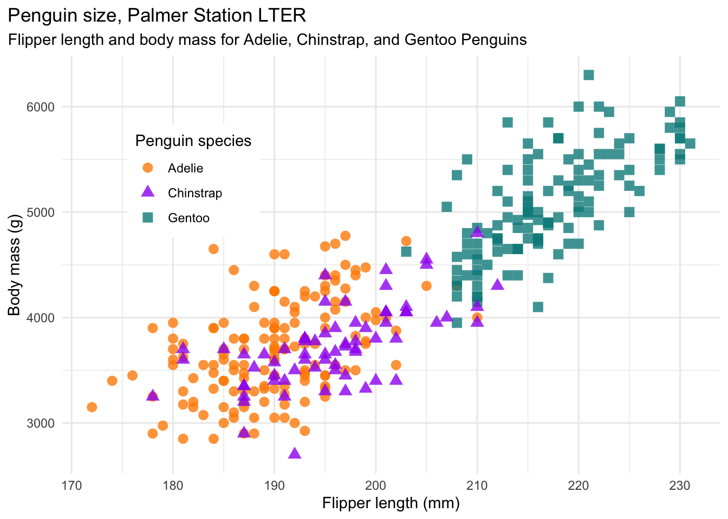
Data exploration: penguins

Slide 24
Machine Learning

Slide 25
Machine Learning: definition
"The field of study that gives computers the ability to learn without being explicitly programmed.”
- Arthur Samuel
“A computer program is said to learn from experience E with respect to some set of tasks T and performance measure P if its performance at tasks in T, as measured by P, improves with experience E.”
- Tom M. Mitchell (prominent Machine Learning researcher)

Slide 26
Machine Learning: definition
“A computer program is said to learn from experience E with respect to some set of tasks T and performance measure P if its performance at tasks in T, as measured by P, improves with experience E.”
T = determine what species of penguins a penguin is
E = previously collected data from penguins
(flipper length, body mass, bill length and bill depth)
P = a performance metric (e.g. accuracy)

Slide 27

Algorithm: decision tree
Flipper length > X
Bill length > Y
Adélie
Chinstrap
Gentoo

Slide 28

Data vocabulary
Feature matrix X
Describes the data. The attributes to base predictions on.
Shape N x M (number of samples x number of features)
Example: for each penguin, we have bill length, bill depth, body mass and flipper length. The shape of the feature matrix would be N (number of penguins) x 4.
Target vector y
Describes the output. The label that you want to predict.
Shape N (one output for every data point)
Example: if we have recorded the features of 200 penguins, our y would contain the corresponding species of those 200 penguins (3 different options).

Slide 29
Palmer Penguins: machine learning in practice

Slide 30
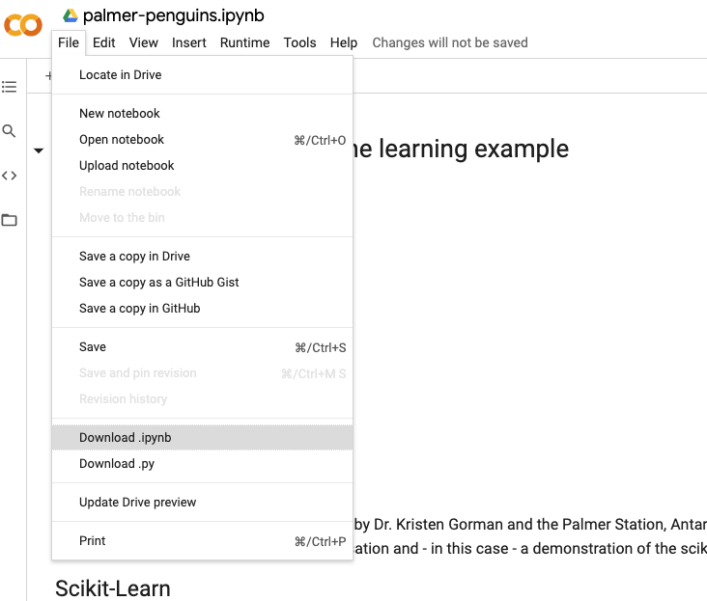
Google Colab: gdd.li/ds_taster
Opened in ‘Playground Mode’
Download it from github: https://gdd.li/ds_taster_github
Save the file locally

Slide 31
What next?

Slide 32

Today
What is data science and examples of data science projects
What the role of a data scientist is
What machine learning is
Example of a machine learning project with scikit-learn

Slide 33
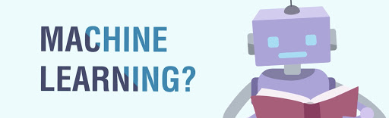
Data Science with Python Foundation
Data exploration
Advance your knowledge on Pandas
Visualisations with matplotlib and beyond
Machine learning concepts
Important concepts such as supervised/unsupervised learning, overfitting/underfitting, regularisation, etc.
Learn how to choose the right algorithm for your task
Machine learning in scikit-learn from A-Z
Preprocessing, pipelines and beyond!
>> Offers certification!

Slide 34
Questions?

